Slide 1
EMS702UP Statistical Thinking and Applied Machine Learning
W3.1 Hypothesis Testing
Jun Chen

Slide 2
Introduction to Hypothesis Testing
Data must be interpreted in order to discover meaning. We can interpret data by assuming a specific structured outcome and use statistical methods to confirm or reject the assumption.
The assumption is called a hypothesis and the statistical tools legitimately used for this purpose are called statistical hypothesis tests.
Any assumptions made may or may not be true but you must always be sure of your grounds for using a given statistical tool. Effectively you will find that you will be asked to decide which of two statements, each called an hypothesis, is the more likely to be true.
Whenever we want to make claims about the distribution of data or whether one set of results are different from another set of results in applied machine learning, we must rely on statistical hypothesis tests.
Statistical hypothesis tests is concerned with making decisions concerning populations and population parameters on the basis of available evidence.
You should be clear from the outset that the statistical tools you will study here will not allow you to prove anything, but they will allow you to measure the strength of the evidence against the hypothesis

Slide 3
Introduction to Hypothesis Testing
Statistical hypothesis tests are important for quantifying answers to questions about samples of data.
The interpretation of a statistical hypothesis test requires a correct understanding of p-values and critical values.
Regardless of the significance level, the finding of hypothesis tests may still contain errors.
You should be clear from the outset that the statistical tools you will study here will not allow you to prove anything, but they will allow you to measure the strength of the evidence against the hypothesis

Slide 4
Statistical Hypothesis Testing – Types of statements
In statistics, when we wish to start asking questions about the data and interpret the results, we use statistical methods that provide a confidence or likelihood about the answers
In Science, we investigate a hypothesis. Similarly, in statistics, a hypothesis test calculates some quantity under a given assumption (statement or claim). The result of the test allows us to interpret whether the statement holds or whether the statement has been violated.
There two types of statements:
Statements that do not need to be back up by facts and figures, they are a matter of opinion.
E.g., Lux, makers of the best luxury cars
Statements that contain information of a numerical nature can often be investigated by taking random samples of the objects or quantities in question and investigating the likelihood that a statement or hypothesis concerning them is true.
E.g, the model skills of Model 1 and Model 2 are the same

Slide 5
Statistical Hypothesis Testing – Types of statements
We usually try to establish a pair of hypotheses, called a null hypothesis (or hypothesis Zero/H0) and an alternative hypothesis (or hypothesis one/H1) and then investigate how the evidence that we have supports one hypothesis more than the other.
H0: also called the default statement or the statement that nothing has changed. It is the statement of the test fails to be rejected.
H1: the violation of the test statement, meaning some other hypothesis. It is when the statement of the test (H0) does not hold and is rejected at some level of significance.
E.g., a demolition engineer might be interested in the burn rate of fuses connected to explosive devices and on the basis of experience hypothesise that the mean burn rate (say $μ$) is $600 mm/sec⁡$. A colleague may disagree and claim that the mean burn rate is greater than $600 mm/sec⁡$.
$$H0: μ=600$$
$$H1: μ>600$$
Before we can reject or fail to reject the null hypothesis, we must interpret the result of the test.

Slide 6
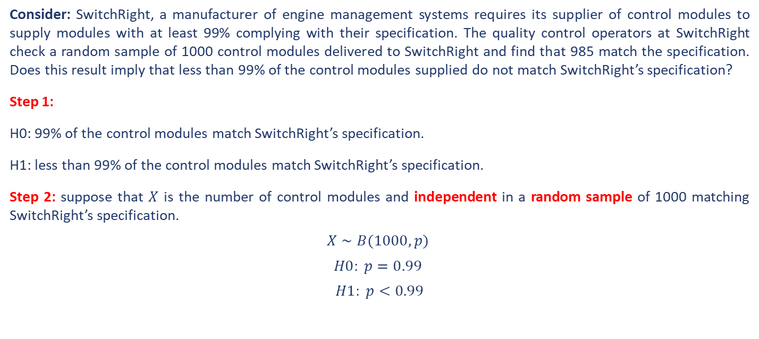
Introduction – Statistical Hypothesis Interpretation
Consider: SwitchRight, a manufacturer of engine management systems requires its supplier of control modules to supply modules with at least 99% complying with their specification. The quality control operators at SwitchRight check a random sample of 1000 control modules delivered to SwitchRight and find that 985 match the specification. Does this result imply that less than 99% of the control modules supplied do not match SwitchRight’s specification?
Step 1:
H0: 99% of the control modules match SwitchRight’s specification.
H1: less than 99% of the control modules match SwitchRight’s specification.
Step 2: suppose that $X$ is the number of control modules and independent in a random sample of 1000 matching SwitchRight’s specification.
$$X∼B(1000, p)$$
$$H0: p=0.99$$
$$H1: p<0.99$$

Slide 7
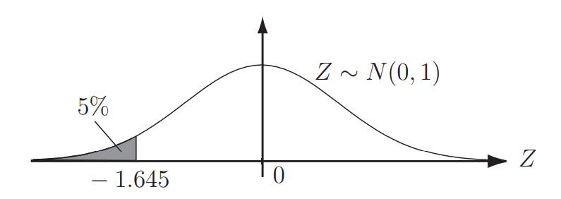
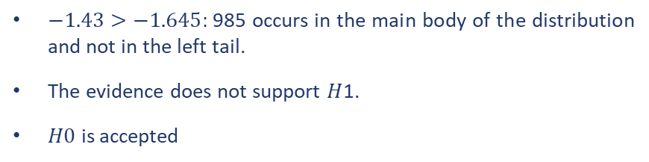


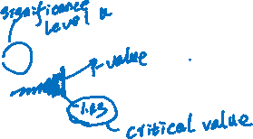
Introduction – Statistical Hypothesis Interpretation
Step 3: $X∼B(1000, p) H0: p=0.99$ $H1: p<0.99$
$$μ=np=1000×0.99=990; σ=\sqrt{np(1−p)}=\sqrt{1000×0.99×0.01}=3.15$$
$$(a) np>5 and (b) n(1−p)>5$$
$$B(1000, 0.99)≈N(990, 3.152 )$$
Step 4: The sample value obtained is 985 and we now assess how close 985 is to the expected result of 990 by defining a remote left tail (in this case) of the normal distribution and asking if the number 985 occurs in the left tail of the distribution or in the main body of the distribution.
$$P(X≤985)=P(Z≤\frac{985.5−990}{3.15}) = P(Z≤−1.43)$$
$−1.43>−1.645:$985 occurs in the main body of the distribution and not in the left tail.
The evidence does not support $H$1.
$H0$ is accepted
Note that this result does not prove that the claim is true.

Slide 8
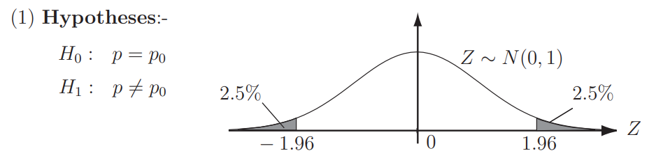
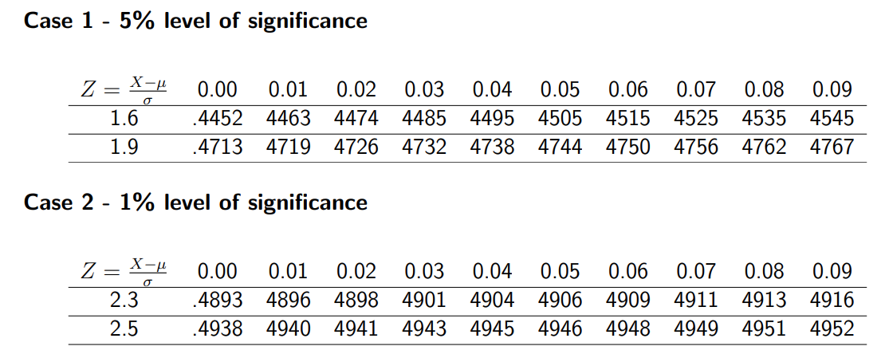
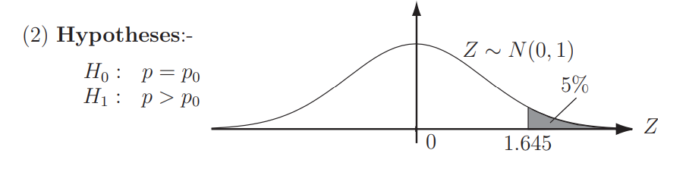
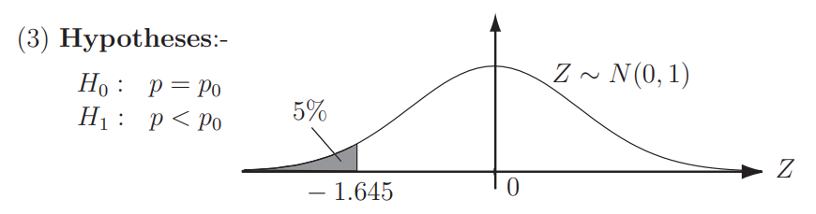
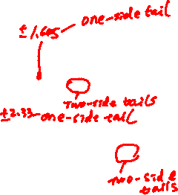

Introduction – Statistical Hypothesis Interpretation

Slide 9
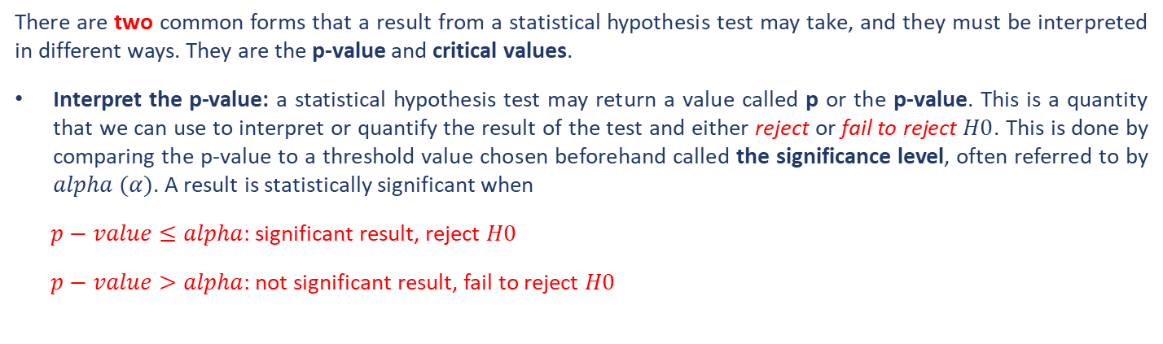
Introduction – Statistical Hypothesis Interpretation
There are two common forms that a result from a statistical hypothesis test may take, and they must be interpreted in different ways. They are the p-value and critical values.
Interpret the p-value: a statistical hypothesis test may return a value called p or the p-value. This is a quantity that we can use to interpret or quantify the result of the test and either reject or fail to reject $H0$. This is done by comparing the p-value to a threshold value chosen beforehand called the significance level, often referred to by $alpha (α)$. A result is statistically significant when
$p−value≤alpha$: significant result, reject $H0$
$p−value>alpha$: not significant result, fail to reject $H0$
The p-value is a measure of how likely the data sample would be observed if $H0$ is true
$$P\left(data \right| hypothesis)$$

Slide 10
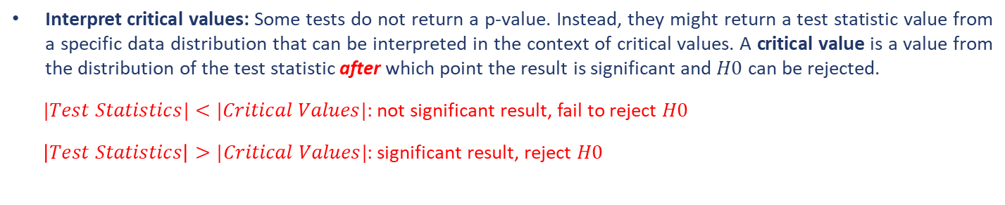

Introduction – Statistical Hypothesis Interpretation
Interpret critical values: Some tests do not return a p-value. Instead, they might return a test statistic value from a specific data distribution that can be interpreted in the context of critical values. A critical value is a value from the distribution of the test statistic after which point the result is significant and $H0$ can be rejected.
$|Test Statistics|<|Critical Values|$: not significant result, fail to reject $H0$
$\left|Test Statistics\right|>|Critical Values|$: significant result, reject $H0$
The p-value is calculated from the critical value by retrieving the probability from the test statistics cumulative density function (CDF).
The interpretation of the p-value and critical values does not mean that $H0$ is true or false. It does mean that we have chosen to reject or fail to reject $H0$ at a specific statistical significance level based on empirical evidence and the chosen statistical test. You are limited to making probabilistic claims, not crisp binary or true/false claims about the result.

Slide 11
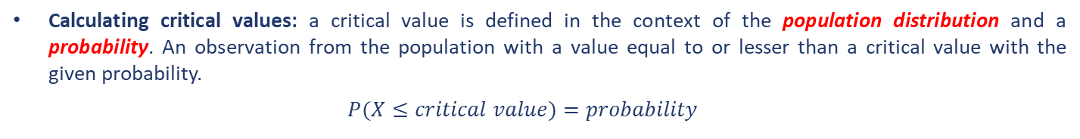
Introduction – Statistical Hypothesis Interpretation
Calculating critical values: a critical value is defined in the context of the population distribution and a probability. An observation from the population with a value equal to or lesser than a critical value with the given probability.
$$P(X≤critical value)=probability$$
$$probability=1−alpha$$
The function above is effectively Cumulative density function (CDF) as it returns the probability for an observation equal to or lesser than a specific value from the distribution.
The inverse of the CDF is called the percent point function (PPF), which returns the observation value (i.e., critical value) for the provided probability that is less than or equal to the provided probability.
$$SciPy→ppf()$$

Slide 12
Introduction – Errors in Statistical Tests
The interpretation of a statistical hypothesis test is probabilistic. That means that the evidence of the test may suggest an outcome and be mistaken. For example, if alpha was $5\%$, it suggests that (at most) 1 time in 20 that $H0$ would be mistakenly rejected because of the statistical noise in the data sample.
Type I Error: The incorrect rejection of a true $H0$, called a false positive.
Type II Error: The incorrect failure of rejecting a false $H0$, called a false negative.
All statistical hypothesis tests have a chance of making either of these types of errors.
False findings or false discoveries are more than possible; they are probable.
Ideally, we want to choose a significance level that minimises the likelihood of one of these errors.
Nevertheless, these types of errors are always present and must be kept in mind when presenting and interpreting the results of statistical tests. It is also a reason why it is important to have findings independently verified.

Slide 13

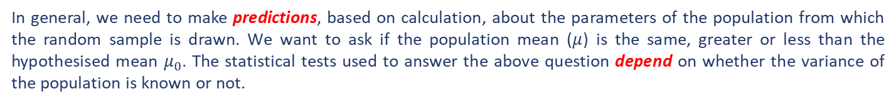



Parametric Methods – Tests for a Single Sample
Tests concerning a single mean
In general, we need to make predictions, based on calculation, about the parameters of the population from which the random sample is drawn. We want to ask if the population mean ($μ$) is the same, greater or less than the hypothesised mean $μ_{0}$. The statistical tests used to answer the above question depend on whether the variance of the population is known or not.
Case 1 – Population variance known
$H1:μ≠μ_{0}$
$$H0:μ=μ_{0} H1:μ>μ_{0}$$
$H1:μ<μ_{0}$
Drawing samples of size $n$ from the population, if $n$ is large (say $n ≥ 30$) then, because of the CLT, $\overline{x}\sim N(μ$, $σ_{n}^{2})$
$$σ_{n}=\frac{σ}{\sqrt{n}}$$
$$Z=\frac{(\overline{x}−μ_{0})}{σ_{n}}$$
$Z$ is the test statistic to be compared with the critical values at different significance values.

Slide 14

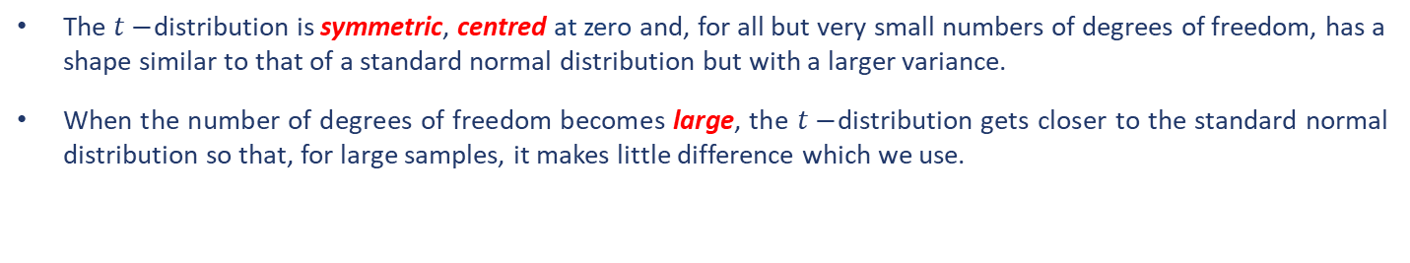


Parametric Methods – Tests for a Single Sample
Tests concerning a single mean
Case 2 – Population variance unknown
$$s^{2}=\frac{\sum{{(x−\overline{x})}^{2}}}{n−1}$$
$$T=\frac{(\overline{x}−μ_{0})}{s_{n}}$$
$$where, s_{n}=\frac{s}{\sqrt{n}}$$
The test statistic $T$ is divided by an estimate, which is itself random. Therefore, $T$ does not have a standard normal distribution. Instead, it has a distribution called Student’s $t−$distribution (named for the pseudonym Student by Villiam Sealy Cosset) on $n−1$ degrees of freedom.
The $t−$distribution is symmetric, centred at zero and, for all but very small numbers of degrees of freedom, has a shape similar to that of a standard normal distribution but with a larger variance.
When the number of degrees of freedom becomes large, the $t−$distribution gets closer to the standard normal distribution so that, for large samples, it makes little difference which we use.

Slide 15
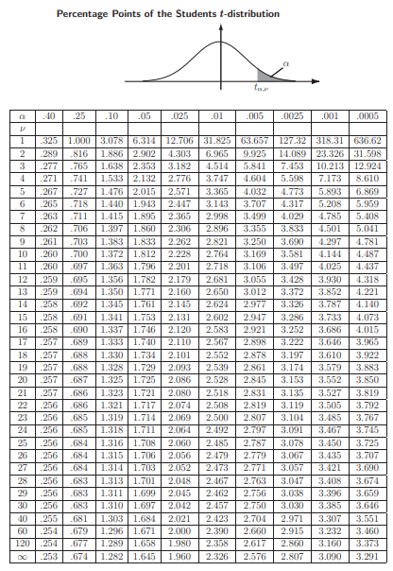


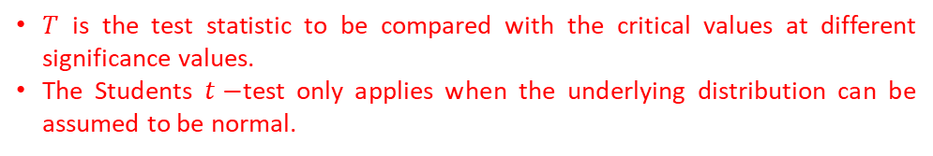
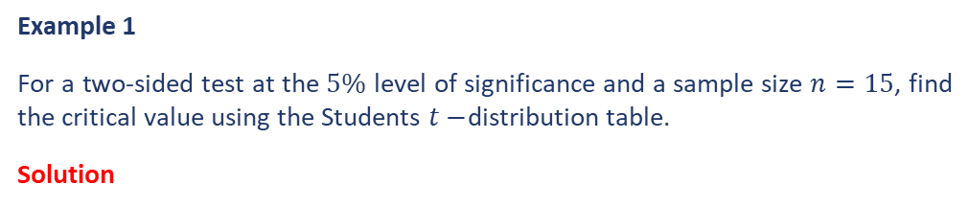
Parametric Methods – Tests for a Single Sample
Tests concerning a single mean
Case 2 – Population variance unknown
$$T=\frac{(\overline{x}−μ_{0})}{s_{n}}$$
Example 1
For a two-sided test at the $5\%$ level of significance and a sample size $n=15$, find the critical value using the Students $t−$distribution table.
Solution
$T$ is the test statistic to be compared with the critical values at different significance values.
The Students $t−$test only applies when the underlying distribution can be assumed to be normal.

Slide 16
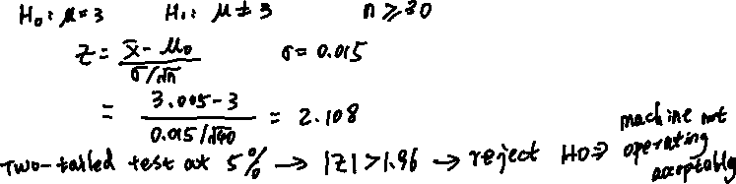
Parametric Methods – Tests for a Single Sample
Example 2
Dishwasher powder is poured into the cartons in which it is sold by an automatic dispensing machine which is set to dispense 3 kg of powder into each carton. In order to check that the dispensing machine is working to an acceptable standard (i.e. does not need adjustment), a production engineer takes a random samples of 40 cartons and weighs them. It is found that the mean weight of the sample is 3.005 kg. It is known that the dispensing machine operates with a standard deviation of 0.015 kg and that the manufacturer of the powder is willing to rely on a 5% level of significance. Does the sample provide the engineer with sufficient evidence that the true mean is not 3.00 kg and so the machine requires adjustment?
Solution

Slide 17
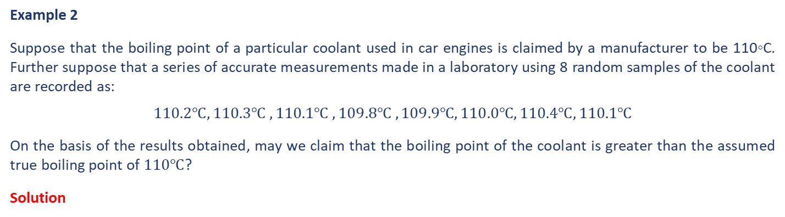
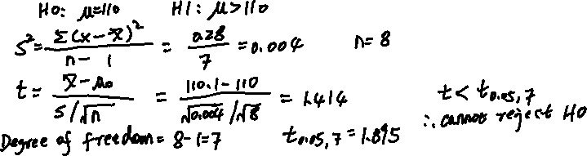
Parametric Methods – Tests for a Single Sample
Example 2
Suppose that the boiling point of a particular coolant used in car engines is claimed by a manufacturer to be 110◦C. Further suppose that a series of accurate measurements made in a laboratory using 8 random samples of the coolant are recorded as:
$$110.2℃, 110.3℃ , 110.1℃ , 109.8℃ , 109.9℃, 110.0℃, 110.4℃, 110.1℃$$
On the basis of the results obtained, may we claim that the boiling point of the coolant is greater than the assumed true boiling point of $110℃$?
Solution

Slide 18
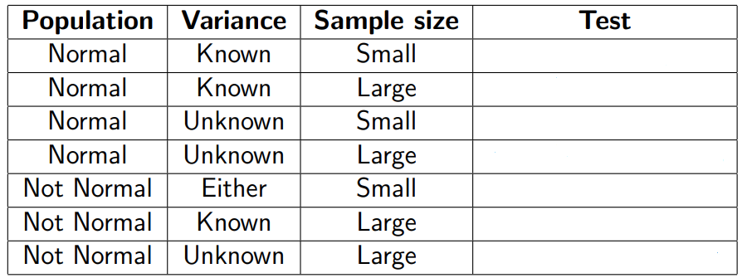
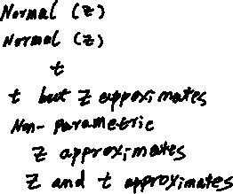
Parametric Methods – Tests for a Single Sample
Example 3
For the tests concerning single sample, the table below summarise difference scenarios we may encounter. Fill in the appropriate statistical hypothesis test methods for those scenarios.
Solution

Slide 19
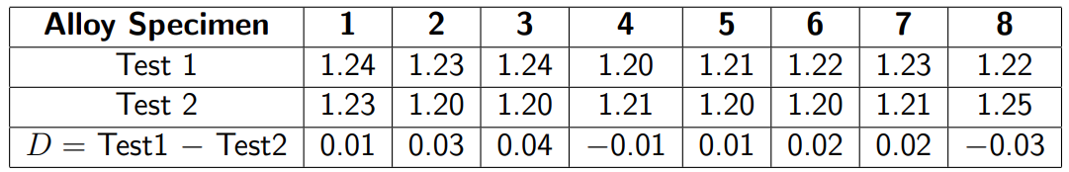
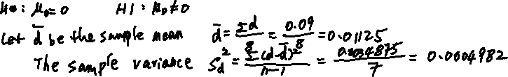
Parametric Methods – Tests for a Single Sample
Tests concerning paired data – the difference between the two samples are considered essentially as a single sample.
Example 4
Two different methods of analysis were used to determine the levels of impurity present in a particular aircraft quality aluminium alloy. Eight specimens were analysed using both methods. Does the available evidence suggest that both methods lead to the same results?
Solution

Slide 20
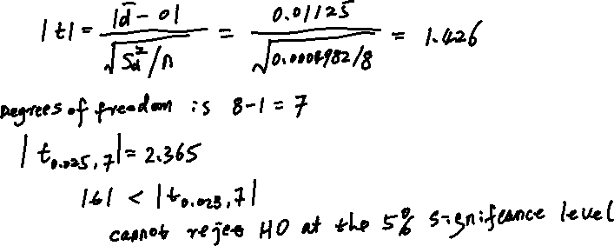
Parametric Methods – Tests for a Single Sample
Example 4 Continued…
Solution

Slide 21
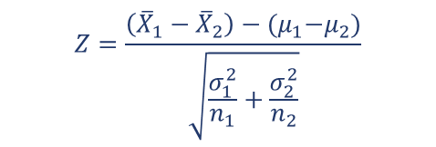

Parametric Methods – Tests for Multiple Samples
Two or more random samples each drawn from independent populations. Note that in general the samples will be of different sizes. Cases involving samples of the same size, while included, should be regarded as special cases.
Case 1: Two independent populations each with a known variance
A sample of size $n_{1}$ is drawn from $X_{1}∼N(μ_{1}, σ_{1}^{2}$) and a sample of size $n_{2}$ is drawn from $X_{2}∼N(μ_{2}, σ_{2}^{2}$) .
Considering the difference $μ_{1}−μ_{2}$ and writing null hypotheses of the form
$H0:μ_{1}−μ_{2}=Value$
$Value$ will often be zero
$E\left({\overline{X}}_{1}−{\overline{X}}_{2}\right)=$ $μ_{1}−μ_{2}$ $V\left({\overline{X}}_{1}−{\overline{X}}_{2}\right)=\frac{σ_{1}^{2}}{n_{1}}+\frac{σ_{2}^{2}}{n_{2}}$
$$Z=\frac{\left({\overline{X}}_{1}−{\overline{X}}_{2}\right)−{(μ}_{1}−μ_{2})}{\sqrt{\frac{σ_{1}^{2}}{n_{1}}+\frac{σ_{2}^{2}}{n_{2}}}}$$

Slide 22



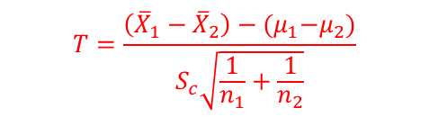
Parametric Methods – Tests for Multiple Samples
Case 2: Two independent populations each with an unknown but equal variance
A sample of size $n_{1}$ is drawn from $X_{1}∼N(μ_{1}, σ_{1}^{2}$) and a sample of size $n_{2}$ is drawn from $X_{2}∼N(μ_{2}, σ_{2}^{2}$) .
$$σ_{1}^{2}=σ_{2}^{2}=?$$
Considering the difference $μ_{1}−μ_{2}$ and writing null hypotheses of the form
$H0:μ_{1}−μ_{2}=Value$
$E\left({\overline{X}}_{1}−{\overline{X}}_{2}\right)=$ $μ_{1}−μ_{2}$ $V\left({\overline{X}}_{1}−{\overline{X}}_{2}\right)=\frac{σ_{1}^{2}}{n_{1}}+\frac{σ_{2}^{2}}{n_{2}}$
$$T=\frac{\left({\overline{X}}_{1}−{\overline{X}}_{2}\right)−{(μ}_{1}−μ_{2})}{S_{c}\sqrt{\frac{1}{n_{1}}+\frac{1}{n_{2}}}}$$
$$S_{c}^{2}=\frac{\left(n_{1}−1\right)S_{1}^{2}+\left(n_{2}−1\right)S_{2}^{2}}{n_{1}+n_{2}−2}$$
$S_{c}^{2}$ has $n_{1}+n_{2}−2$degrees of freedom

Slide 23
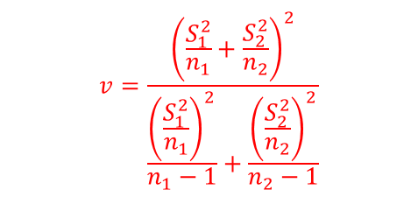

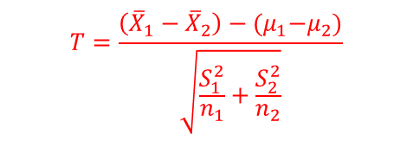
Parametric Methods – Tests for Multiple Samples
Case 3: Two independent populations each with an unknown and unequal variance
A sample of size $n_{1}$ is drawn from $X_{1}∼N(μ_{1}, σ_{1}^{2}$) and a sample of size $n_{2}$ is drawn from $X_{2}∼N(μ_{2}, σ_{2}^{2}$) .
$$σ_{1}^{2}≠σ_{2}^{2}=?$$
Considering the difference $μ_{1}−μ_{2}$ and writing null hypotheses of the form
$H0:μ_{1}−μ_{2}=Value$
$E\left({\overline{X}}_{1}−{\overline{X}}_{2}\right)=$ $μ_{1}−μ_{2}$ $V\left({\overline{X}}_{1}−{\overline{X}}_{2}\right)=\frac{σ_{1}^{2}}{n_{1}}+\frac{σ_{2}^{2}}{n_{2}}$
$$v=\frac{{\left(\frac{S_{1}^{2}}{n_{1}}+\frac{S_{2}^{2}}{n_{2}}\right)}^{2}}{\frac{{\left(\frac{S_{1}^{2}}{n_{1}}\right)}^{2}}{n_{1}−1}+\frac{{\left(\frac{S_{2}^{2}}{n_{2}}\right)}^{2}}{n_{2}−1}}$$
$$T=\frac{\left({\overline{X}}_{1}−{\overline{X}}_{2}\right)−{(μ}_{1}−μ_{2})}{\sqrt{\frac{S_{1}^{2}}{n_{1}}+\frac{S_{2}^{2}}{n_{2}}}}$$
$v$degrees of freedom

Slide 24
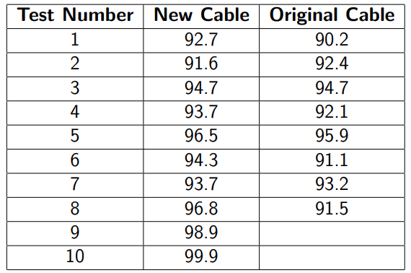
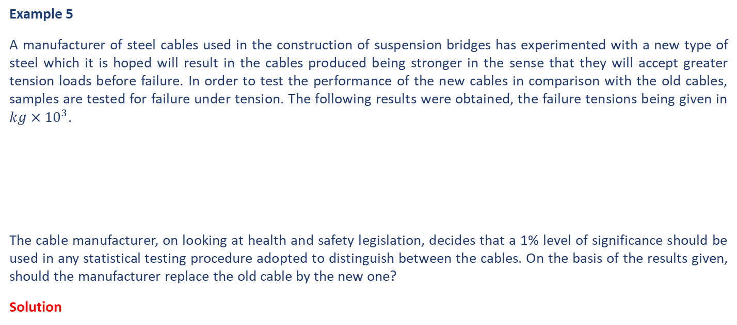
Parametric Methods – Tests for Multiple Samples
Example 5
A manufacturer of steel cables used in the construction of suspension bridges has experimented with a new type of steel which it is hoped will result in the cables produced being stronger in the sense that they will accept greater tension loads before failure. In order to test the performance of the new cables in comparison with the old cables, samples are tested for failure under tension. The following results were obtained, the failure tensions being given in $kg×{10}^{3}$.
The cable manufacturer, on looking at health and safety legislation, decides that a 1% level of significance should be used in any statistical testing procedure adopted to distinguish between the cables. On the basis of the results given, should the manufacturer replace the old cable by the new one?
Solution

Slide 25
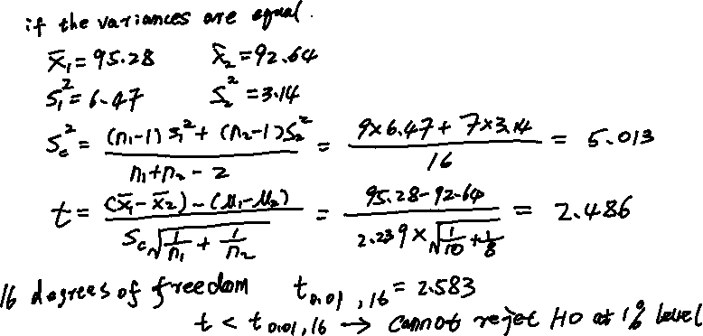
Parametric Methods – Tests for Multiple Samples
Example 5 Continued…
Solution

Slide 26
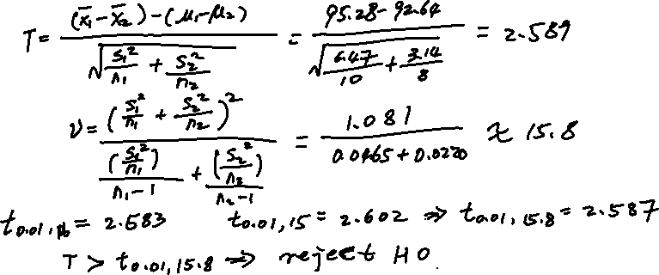

Parametric Methods – Tests for Multiple Samples
Example 5 Continued…
Solution

Slide 27


Parametric Methods – Tests for Multiple Samples
According to the assumptions (i.e., equal or unequal variances of samples from independent normal populations) made, the analysis in Example 5 changes conclusions reached and recommendations made. Therefore, it is necessary to test in order to decide which assumption about the variances is correct.
$${H0: σ}_{1}^{2}=σ_{2}^{2}$$
$${H1: σ}_{1}^{2}≠σ_{2}^{2} H1:σ_{1}^{2}>σ_{2}^{2} H1: σ_{1}^{2}<σ_{2}^{2}$$
In order to carry out the above tests, we use the $F−$distribution, describing the random variable defined by the ratio involving sample and population variances.
$$F=\frac{S_{1}^{2}}{σ_{1}^{2}}/\frac{S_{2}^{2}}{σ_{2}^{2}}$$
Under $H0$, $F$ reduced to $F=S_{1}^{2}/S_{2}^{2}$, with $n_{1}−1$ degrees of freedom in the numerator and $n_{2}−1$ degrees of freedom in the denominator, and is denoted by
$F_{n_{1}−1,n_{2}−1}$

Slide 28
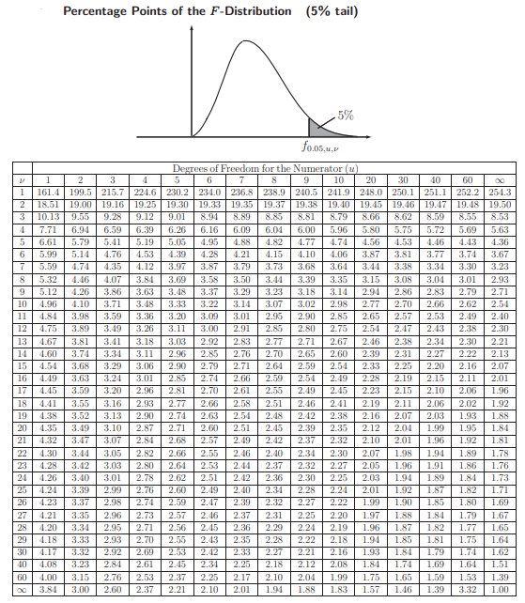
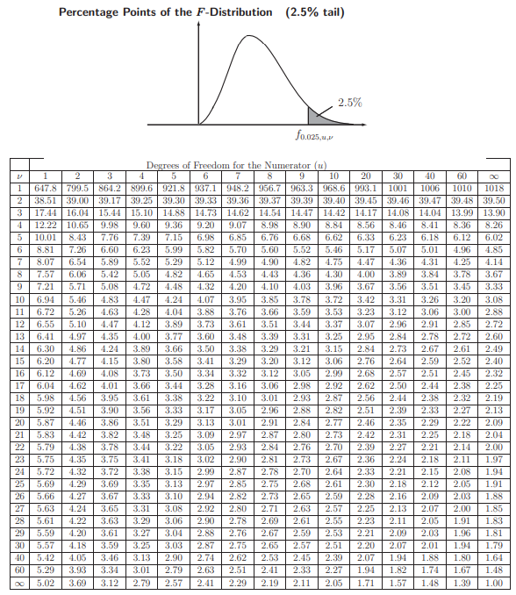
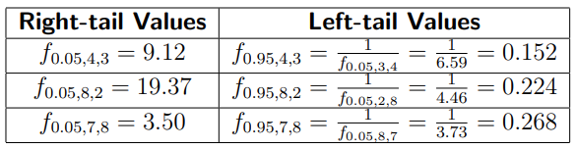
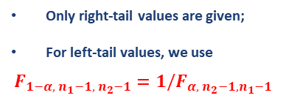
Parametric Methods – Tests for Multiple Samples
Only right-tail values are given;
For left-tail values, we use
$$F_{{1−α, n}_{1}−1, n_{2}−1}=1/F_{α, n_{2}−1,n_{1}−1}$$

Slide 29
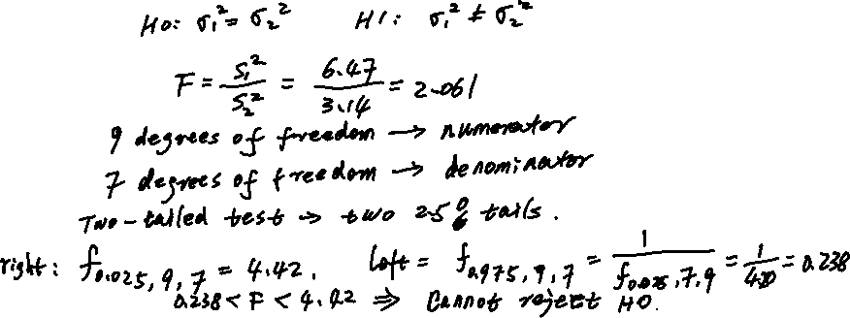
Parametric Methods – Tests for Multiple Samples
Example 6
Use F-test to decide if the populations in Example 5 have equal variances at the 5% level of significance.
Solution

Slide 30
End slide

